Slide 1
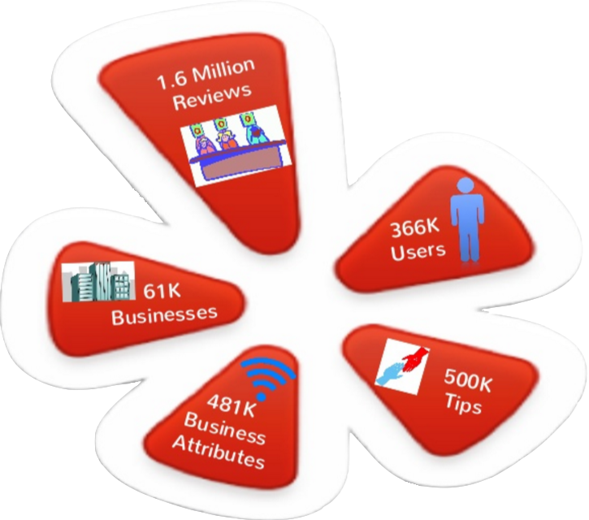
Yelp Data Analysis
Notes:
How many people use yelp?
How many read reviews?
How many write reviews?
We’ll walk through what attributes increase the probability of receiving higher stars for a business and what attributes increase the chance of a user getting more fans.

Slide 2
Team Information
Course – Big Data Systems Engineering Using Scala
Professor – Robin Hilyard
Team 7
Team Members: Prateek Mane Zhenchi Yuan
Notes:
How many people use yelp?
How many read reviews?
How many write reviews?
We’ll walk through what attributes increase the probability of receiving higher stars for a business and what attributes increase the chance of a user getting more fans.

Slide 3

Agenda
Goals
DataSet Description
Milestones
Data Cleansing
Tasks Description
User Reviews
Finding Business Competitors
Programming in Scala
Test Cases
Dependencies Used
Application Scalability and Evaluation Criteria
Software To Be Used
Notes:
Converted from JSON

Slide 4
Goals
To understand sentiment of users
To help restaurants grow their business by knowing their competitors
Notes:
Converted from JSON

Slide 5
DataSet Description
Data Source: https://www.yelp.com/dataset_challenge
Data Format: JSON
Business – list of businesses
Basic Attributes (Business_id, name, categories)
Address (neighborhoods, full_address, city, state, latitude, longitude)
Reviews (stars, review_count)
Time (open: True/False, hours)
Review – list of customers’ review
business_id, user_id, stars, text, date, votes
Notes:
Converted from JSON

Slide 6
Milestones
First Week <by Mar 25th,2016> Assigned to Prateek
1. Creation of project repository
2. Software environment configuration
3. Requirement analysis and system structure design
Second Week <by Apr 1st, 2016> Assigned to Prateek
1. Parse JSON data and Data Cleaning
2. Map bigrams with business IDs
3. Finish sentiment analysis on bigrams.
4. Generate Word Cloud
5. Unit test cases
Third Week <by Apr 8th, 2016> Assigned to Hank
1. Business competitors analysis
2. Unit test cases
Fourth Week <by Apr 15th, 2016> Team Task
1. Application deployment on AWS

Slide 7
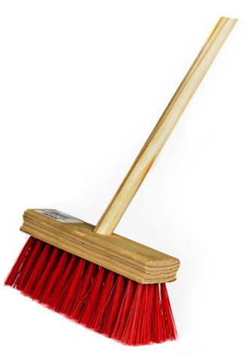
Data Cleansing
Initial dataset:
61,184 business records
436 business categories
Illegal Characters
Interested:
Only in restaurant, food chain and eateries
Approx. 20,000 business records
Approx. 100 business categories
Reviews – 0.2 M

Slide 8
Tasks Description
User Reviews - To conclude all users’ review about one certain restaurant using visual ways.
Finding Business Competitors - To find out competitors in Neighbourhood

Slide 9
First Task - User Reviews
Bigrams
Create Bigram word clouds of positive and negative user reviews.
Methods:-
Creation of basic noun word bags
http://thesaurus.altervista.org -> Synonyms generation
Stanford NLP -> POS Tagging(To find Nouns and Adjectives in the review)
Spark RDD manipulation
Sentiment Analysis On Bigram
Classifying positive and negative Bigrams
Methods:
Stanford NLP -> Sentiment
Generation of WordCloud (Kumo dependency)

Slide 10
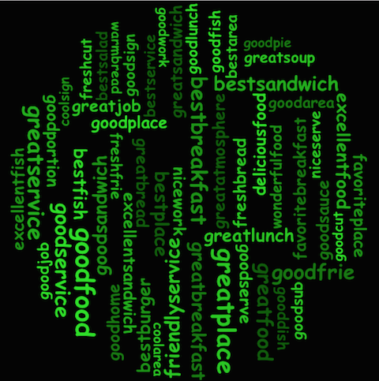
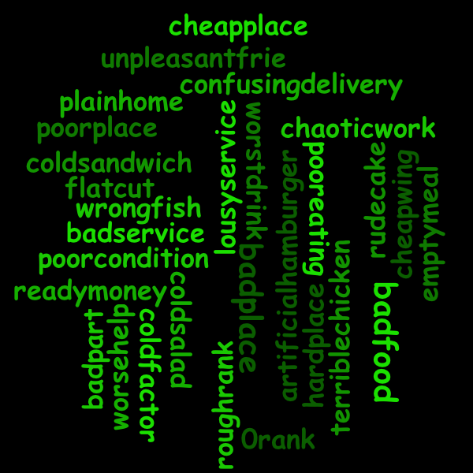
Output of Task 1
Positive Bigrams
Negative Bigrams

Slide 11
Second Task - Finding Business Competitors
For a business, we look out for similar nearby business(upto 10 miles), to find out what advantages they have which helps our business to improve its competitiveness.
Factors to find Competitors:-
Geo location
Categories
E.g. –
Business – Qdoba Category – Mexican
City – Boston State – MA
Total Good Reviews – 20 Total Bad Reviews – 10
Best Reviews – best deals Bad Reviews – place crowded, bad service
Competitor
Name Distance Good Bad Best
Border Café 4 miles unlimited tacos, Overbaked dish, Service
cheap food dirty place
NOTE :- Best (Best column => the best positive review among all Good reviews)

Slide 12
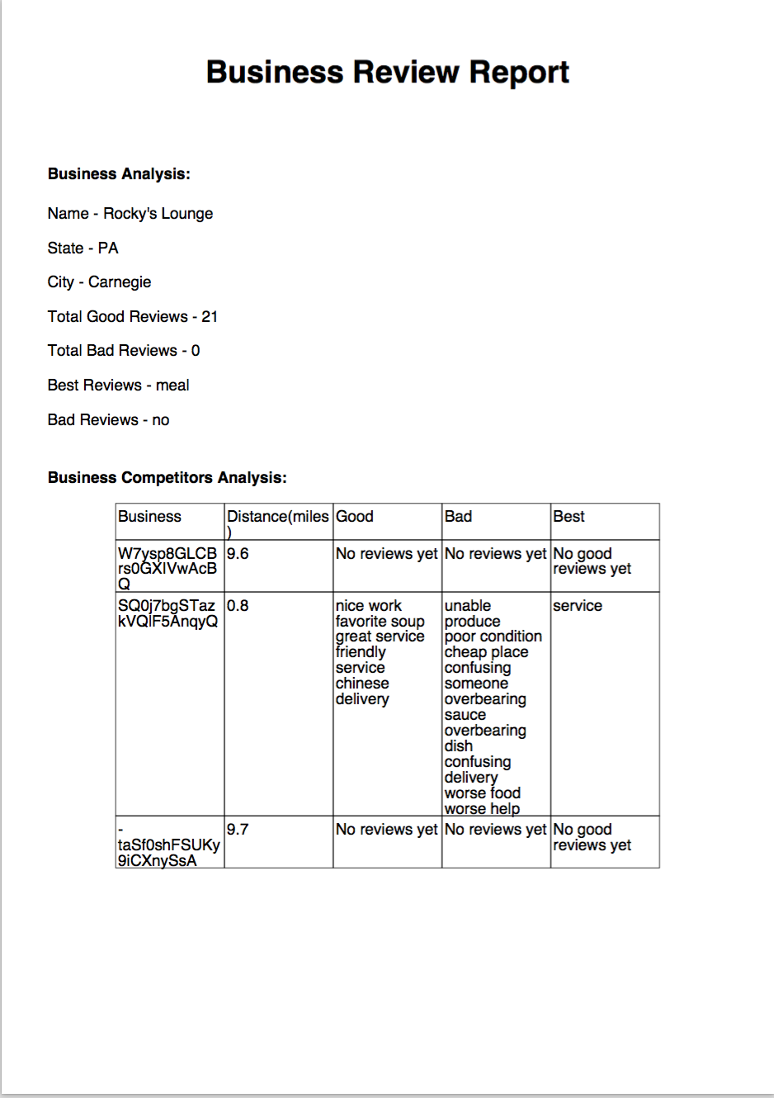
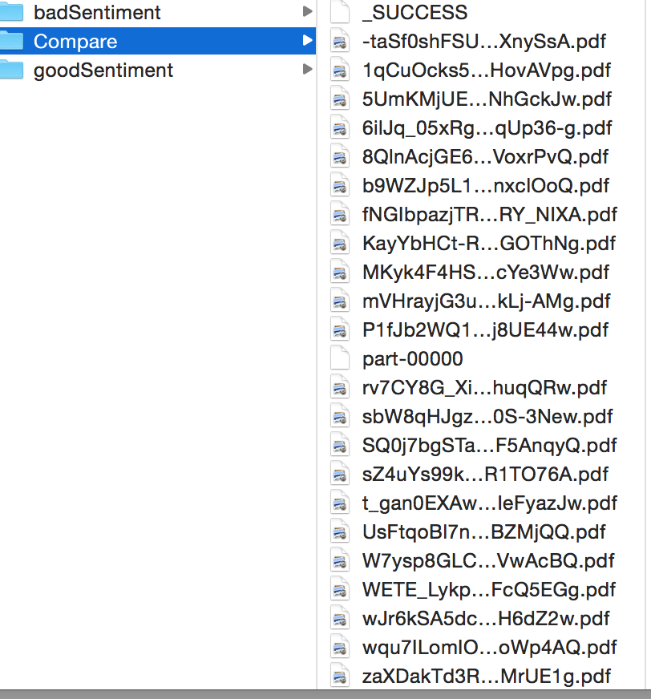
Second Task - Output
The Business PDF Report generated for all the Business
NOTE- A sample file from the application is on github.
UsFtqoBl7naz8AVUBZMjQQ.pdf

Slide 13
Programming in Scala
YelpDataAnalysis (main class)
Initialize everything and realize functions using functions other classes provide
Model:
Business: Every business should be an object, provide methods business need.
WordsBag: The basic words which are used to locate all words that are important, it helps us to generate bigrams
Clean:
DataCleasingUtil: Initialize sparkContext and loading the dataset and saving it to a dataframe.
DataParsingUtil: Cleaning and parsing the dataframe DataCleasingUtil provided, and get bigrams of every reviews.
Visualization/WordCloud:
Analize bigrams DataParsingUtil provided and generate pictures
Compare:
Compare: compare businesses and their competitors, then generate pdfs of every business.
GeneratePdf: Define what should every pdf looks like.

Slide 14
Test Cases
Spark Context should not be null
Extract Keywords
Generate Pictures
Generate PDFs

Slide 15
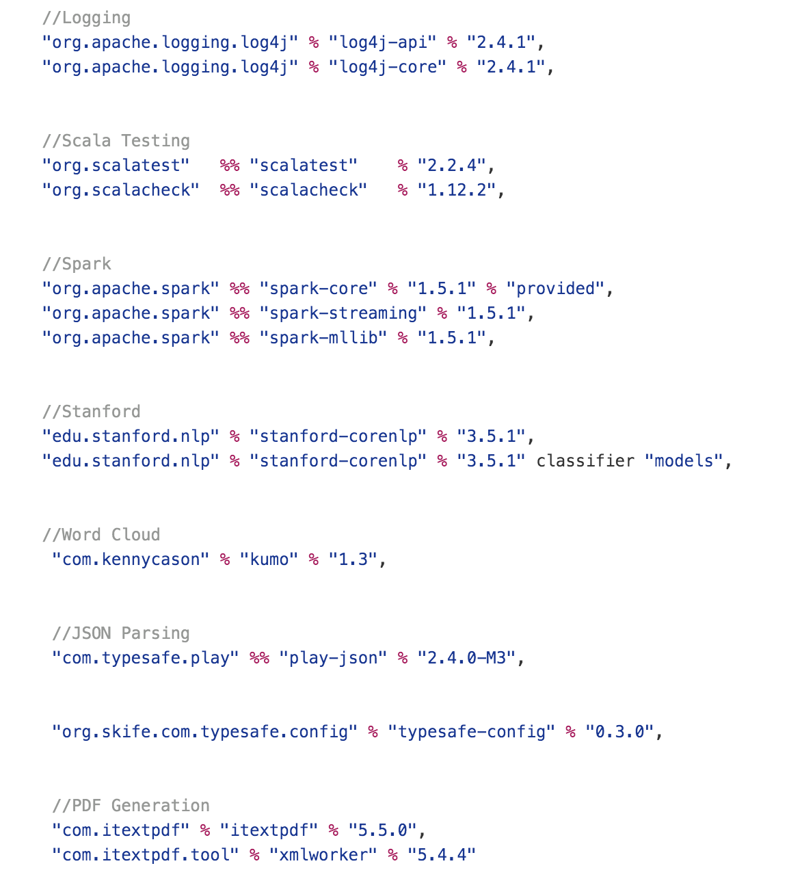
Dependencies Used

Slide 16
Application Scalability and Evaluation Criteria
Scalability
The application is scalable in following ways:-
Wordbags are created with basic nouns. Wordbags = 21 words
The wordbags are scaled up by using an api - http://thesaurus.altervista.org
Final wordbag = 251 words
Thus we get a range of words which helps in scaling the review analysis.
The number of Business Review Report PDF’s created = Number of business id’s
Evaluation Criteria
As discussed with Prof, evaluation criteria was set to generate more than 2000 pdfs.
We generated 10,000 pdfs

Slide 17



Software To Be Used
Notes:
Dependent variables: fans
Independent variables: review_count, average_stars, frequency of review (the number of the reviews per year)
All three independent variables are statistically significant to dependent variables.
Frequency_of_review is negative correlated with number of fans while review_count and averge_ stars are both positively correlated with the number of fans.
That is to say, while holding everything else constant, the more review the user writes, the more the number of fans the user will have.
And while holding everything else constant, the higher the average stars, the more the number of fans the user will have.
Since the frequency_of_review is negatively related to the fans, that is to say, while holding everything else constant, the more frequent the user write a review, the less the number of the fans the user will have.
Users behave differently. Someone who has been a user for a shorter period (2 years) could write the same number of reviews as the one that has been a user for a longer period (5 years). The former might just write reviews too frequently, so their reviews might have a lower quality. And that might be a reason that they has smaller number of fans than the one that write the review less frequently.

Slide 18

QUESTIONS?

